Slide 1
J integral and its role in fracture mechanics
Prof. Aleksandar Sedmak,
University of Belgrade, Serbia
DIVK annual conference, 3.12.2020
dedicated to J.R. Rice’s 80th birthday
Long live, Jim!

Slide 2

Prof. James R. Rice
ECF22 introductory lecture, Belgrade, 2018

Slide 3
J integral as the conservation law
,
For homogeneous materials, and the closed path, J_{k}=0. If the path
contains a crack along axis “1” than J₁ becomes Rice’s J integral

Slide 4
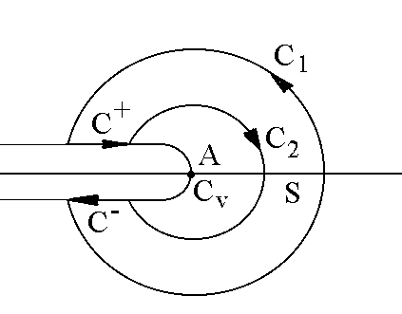
J integral path independency
By taking into account
one gets
By applying diver­gence theorem
for the closed contour C, comprising C₁, C⁺, C₂, C⁻, encompassing an area S.
Contour integral C⁺and C⁻ is zero, so:
proving path independency for 2D plane problem, homogeneous material at least in direction “1”, without thermal, body and inertial forces.

Slide 5
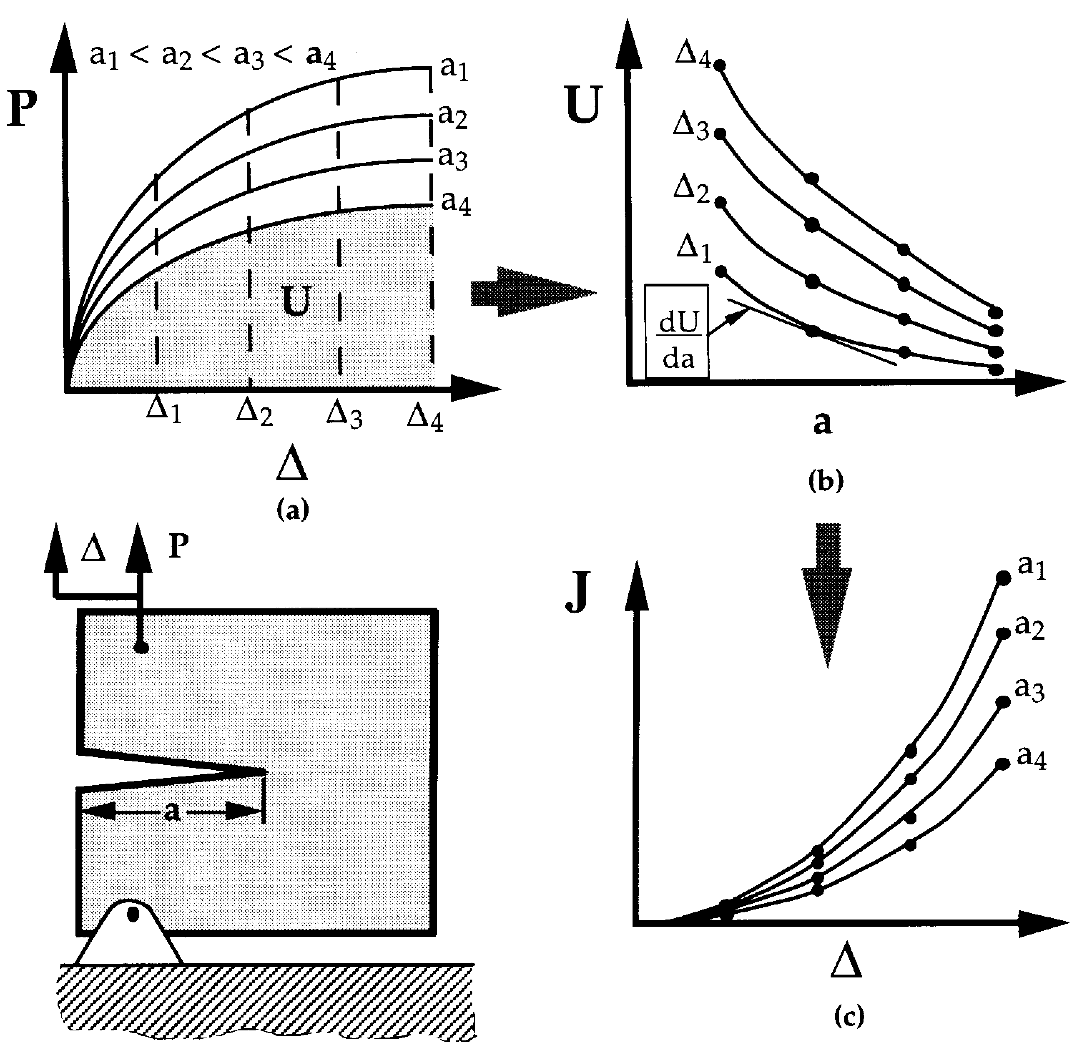
Physical meaning of J integral and practical consequences
It was shown that J integral is valid for the HRR (Hutchinson-Rosengren-Rice) stress-strain fields (non-linear material behavior around crack tip):
It was also shown that J integral
is the energy release rate:
enabling its experimental evaluation. Having also in mind its physical meaning and path independency, it was not very long after 1968 that J integral numerical calculation emerged. Also, by applying HRR fields, analytical calculation was introduced (EPRI).

Slide 6
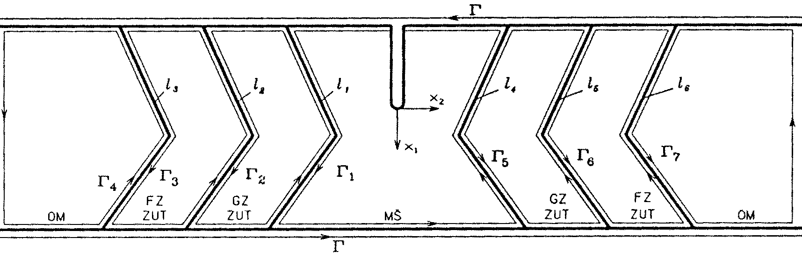
Multimaterial body – welded joint

Slide 7
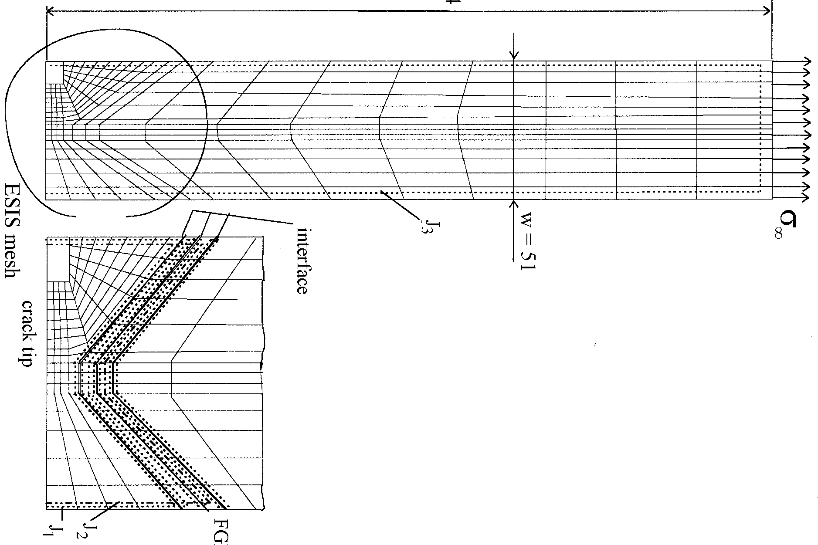
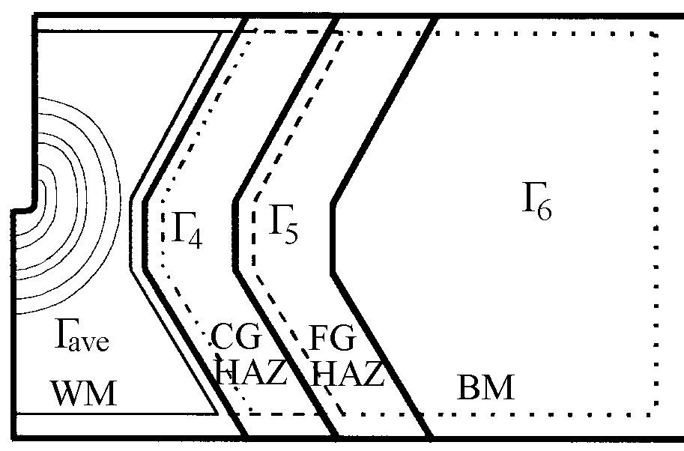
Numerical example
J_{W1}=J₁+J₄,
J_{W2}=J₂+J₄+J₅,
J_{W3}=J₃+J₄+J₅+J₆

Slide 8
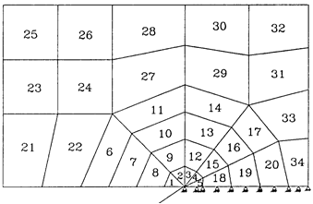
Undermatched welded joint
J₁ (N/mm) | J₂ (N/mm) | J₃ (N/mm) | l₁ (N/mm) | l₂ (N/mm) | l₃ (N/mm) | J_{AVE} (N/mm)
41.306 | 42.278 | 44.679 | -0.790 | 0.341 | -0.350 | 39.715
72.604 | 71.227 | 79.238 | -2.998 | 2.661 | -1.039 | 68.318
100.481 | 95.6042 | 106.957 | -5.582 | 5.808 | -4.167 | 92.567
133.131 | 124.831 | 139.410 | -8.226 | 9.081 | -7.270 | 122.440
160.795 | 149.400 | 166.615 | -11.308 | 12.088 | -10.070 | 148.362
202.666 | 187.190 | 206.002 | -16.322 | 16.497 | -14.327 | 188.772
223.504 | 205.236 | 225.386 | -18.716 | 19.324 | -17.222 | 209.220
247.370 | 225.526 | 247.658 | -21.401 | 23.043 | -20.973 | 232.632
J_{ave} is the average value for 6 inner paths in 3 layers of elements, each with 2x2 Gauss integration point: 8,9,12,15,18; 7,10,13,16,19; 6,11,14,17,20.

Slide 9
As may be seen in Table 1, the finite element results confirm the theoretical analysis of the material interface effect on the J-integral value. The largest difference (J₁ and J₂) is cca 9%, while the numerical error may be estimated to cca 2.5%. On the other hand, for values of the modified J-integral, denoted here as J_{W}), shown in Table 2, one may observe excellent agreement between J_{W1}, J_{W2} and J_{W3}, as well as good agreement (within the limits of numerical error) between these values and J_{AVE}. The relations bet­ween J₁-J₃ and l₁-l₃ with J_{W1-3} are as follows:
J_{W1}=J₁+l₁
J_{W2}=J₂+l₁+l₂
J_{W3}=J₃+l₁+l₂+l₃
J_{AVE} (N/mm) | J_{W1} (N/mm) | J_{W2} (N/mm) | J_{W3} (N/mm)
39.715 | 40.516 | 41.829 | 44.580
68.318 | 69.605 | 70.889 | 77.861
92.567 | 94.899 | 95.830 | 103.016
122.440 | 124.905 | 125.686 | 132.995
148.362 | 149.486 | 150.180 | 157.324
188.772 | 186.343 | 187.365 | 191.850
209.220 | 204.787 | 205.844 | 208.772
232.632 | 225.968 | 227.167 | 228.326

Slide 10
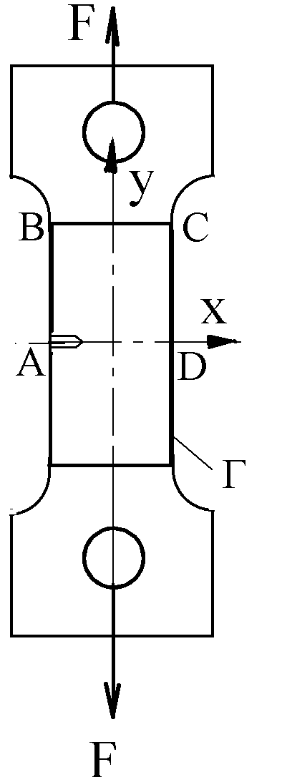
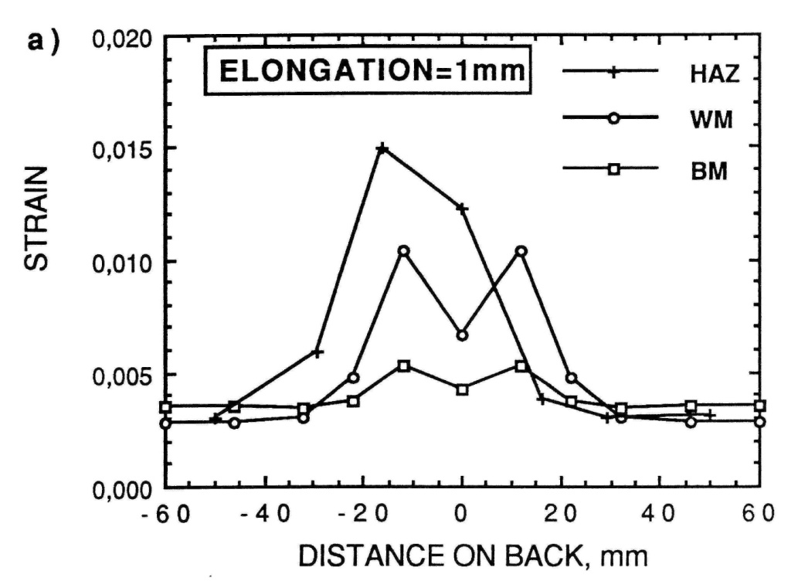
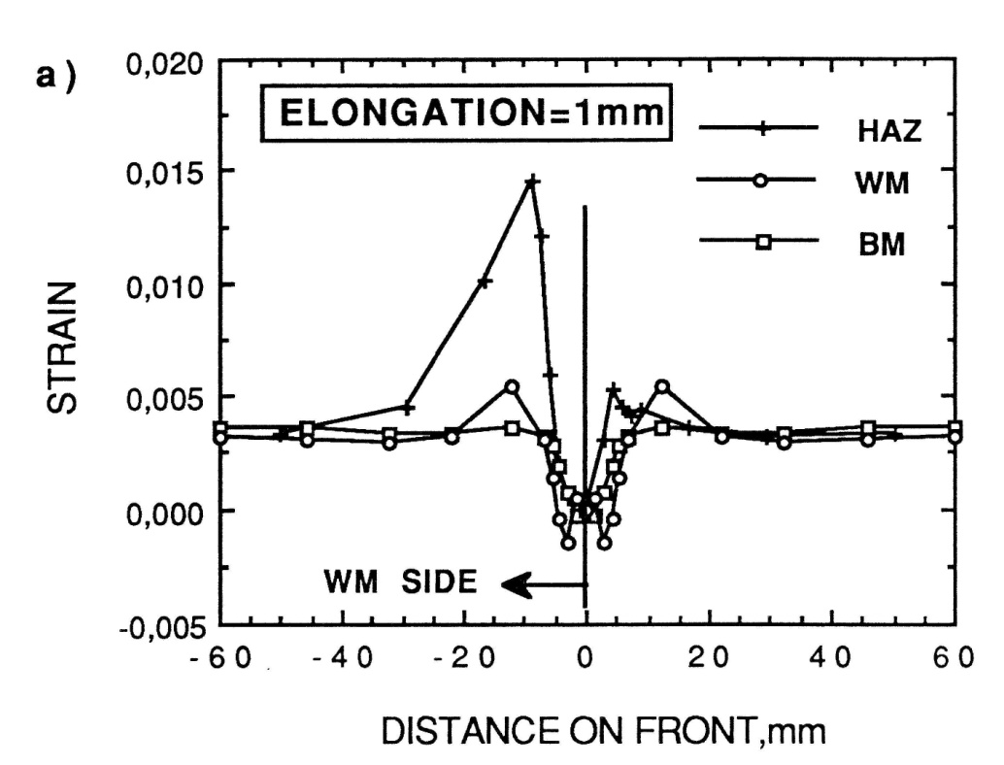
Direct measurement of J integral: tensile panel, elasto-ideal plastic material
.
for AB i CD
for BC
,

Slide 11
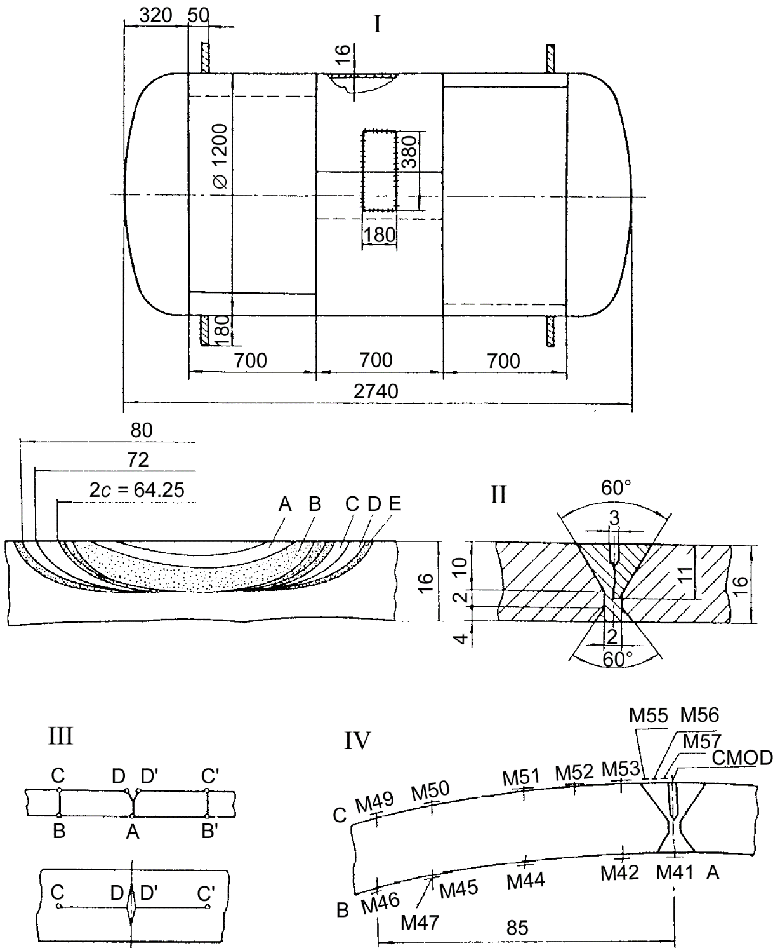
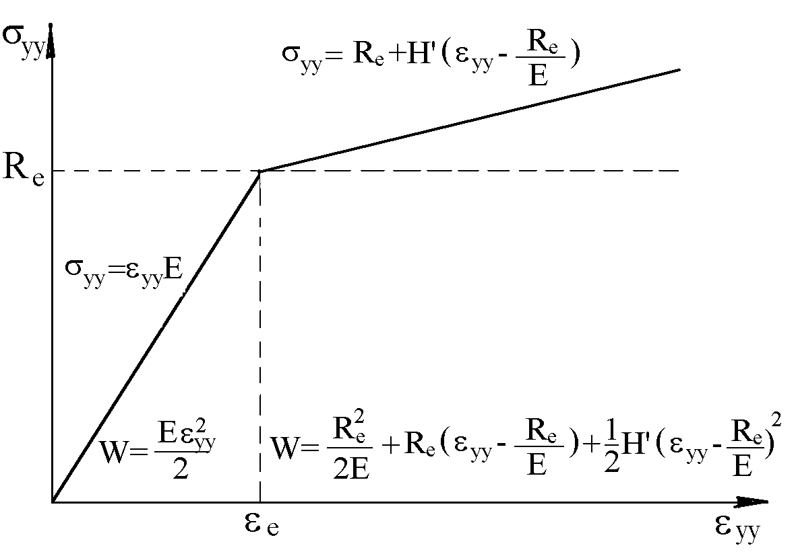
Modifications – strengthening, heterogeneity, biaxial stress state

Slide 12
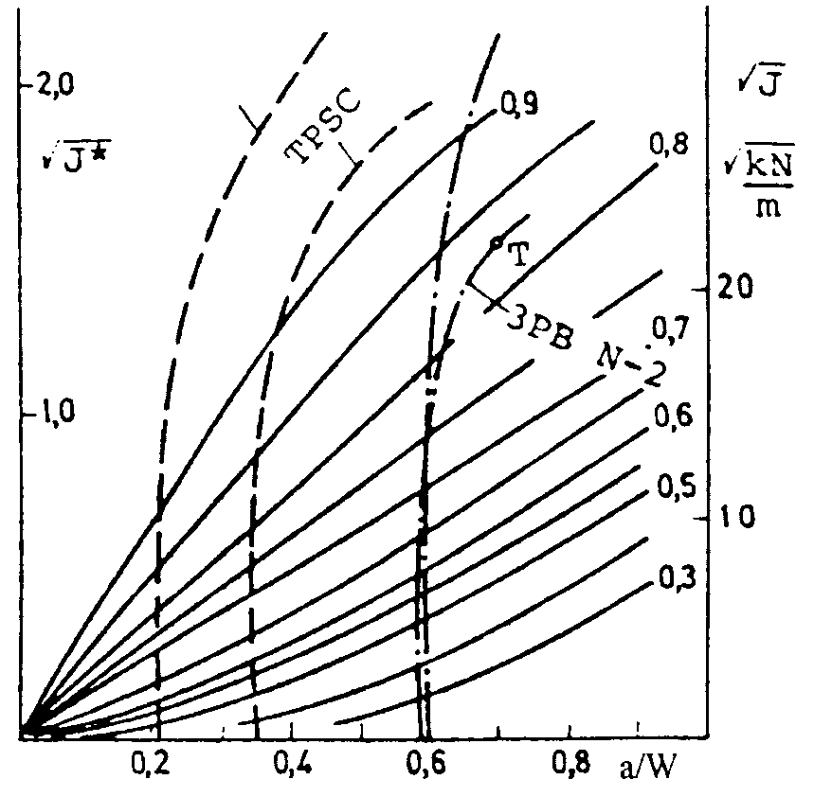
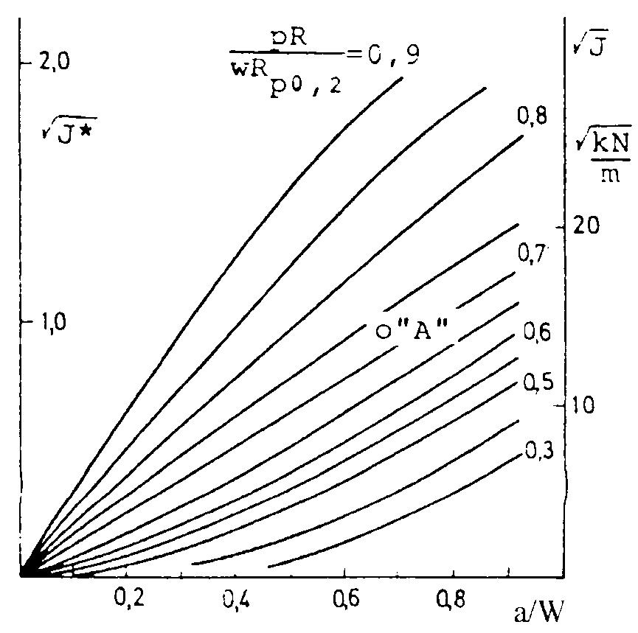
J integral as crack driving force and J-R curve
Concluding remarks: J integral can be used to calculate CDF (fixed crack length, different loading) and to measure J-R curve (both loading and crack length increasing). Intriguing issue is the point “A”! Nevertheless, we can also calculate J-R curve by using micromechanical modelling, but this is something completely different, not to be covered today. Needless to say, it was Rice (and Tracey) who introduced the first micromechanical model for ductile enlargement of voids in triaxial stress fields (J Mech Phys Solids. 1969;17(3):201‐217). It seems that by the end of sixties we already had all tools needed for complete understanding of Fracture Mechanics, which have been only improved and polished in the meantime. Most of them were established by Jim Rice.

Slide 13
Paper published online (www.divk.org.rs) on this occasion
Lesley Banks-Sills, Aleksandar Sedmak
LINEAR ELASTIC AND ELASTO-PLASTIC ASPECTS OF INTERFACE FRACTURE MECHANICS,
Structural Integrity and Life, Vol. 20, No. 3, p. 203-210, 2020
http://divk.inovacionicentar.rs/ivk/ivk20/OnlineFirst.html
Abstract This paper is written on the occasion of J.R. Rice’s 80th birthday. Basically, it presents two aspects of interface fracture mechanics, linear elastic and elasto-plastic, both of them reflecting the long experience of the two authors. Special attention has been focused on the seminal contribution of Jim Rice, still being a great inspiration to researchers in the field of fracture mechanics. Fundamentals that he developed enabled us to build versatile scientific and engineering tools that currently enable the solution of almost any problem related to cracks. Keywords: interface fracture mechanics, bi-material body, J-integral, singular finite element

